Slide 1
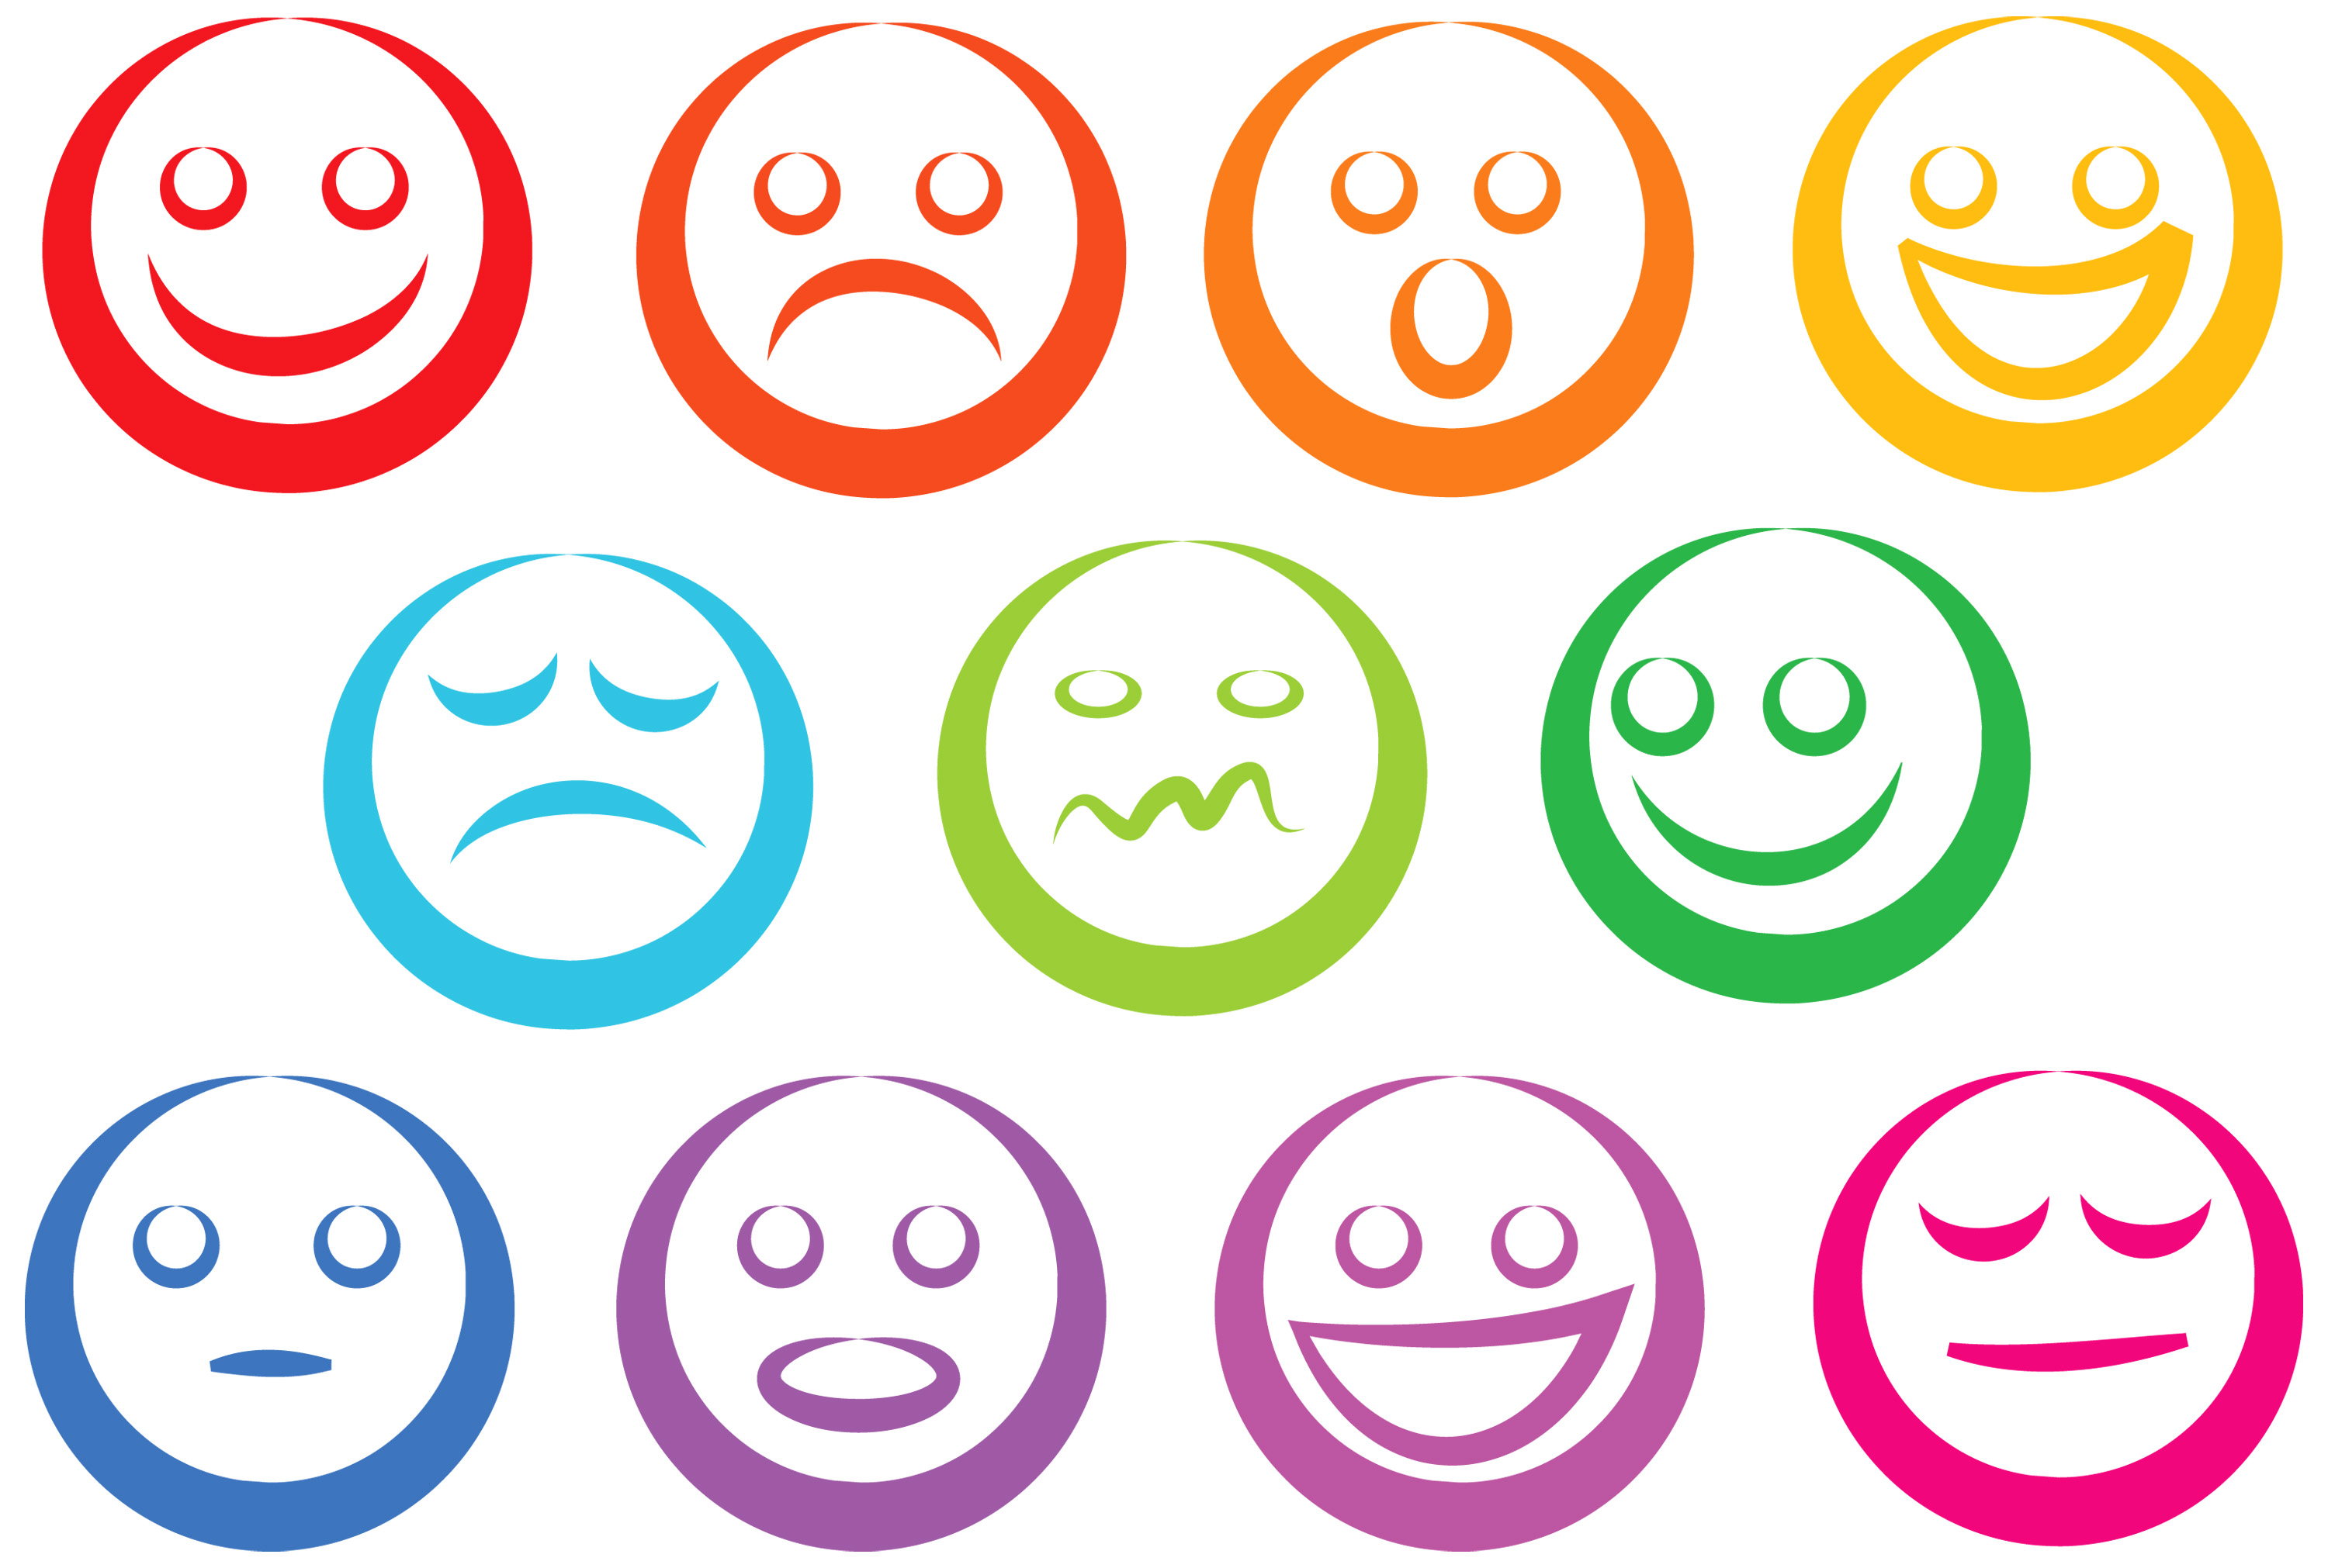

Slide 2
Analyzing Personality through Social Media Profile Picture Choice
Anuj Khasgiwala

Slide 3
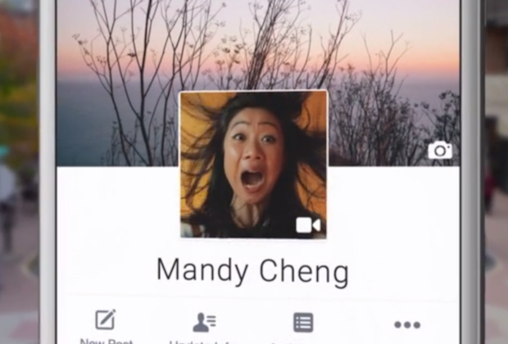
Motivation
Social media images portrays personality
Audience: Twitter users
Dataset: 66000 users
How: using tweets
Interpretation: analysis on aesthetic and facial features and control for demographic variation in image features and personality

Slide 4
Introduction
Freedom to speak or convey
Presentation depends on psychological traits and represent persona
Previous work on user traits(age, gender, occupation etc.)
Choice of Photos are type of behavior associated at least in part with personality expressed by five factor model
Digman Big Five – consisting of openness to experience, conscientiousness, extraversion, agreeableness and neuroticism

Slide 5
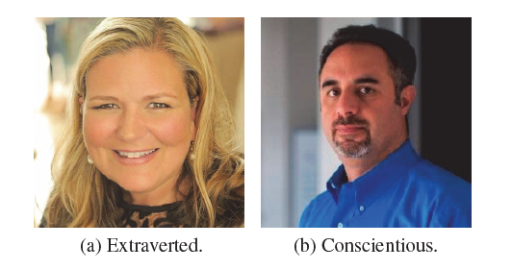
Relation between Personality and Picture

Slide 6
Relation between Personality and Picture
Extravert
Enjoy interacting
High group visibility
Energetic
Use picture involving other people or the once that express more positive emotions
may be more inclined to choose unconventional images and poses, as a general inclination of this type of people for art and novelty.
Conscientiousness
More orderly
Prefer planned behavior
Use frontal photography of themselves
Neuroticism is associated with negative emotions, which could also be reflected through users choices of profile images

Slide 7
Features
Colors, aesthetics, facial presentation, emotions
Compare features with Big Five model.
Previous studies conclusion
Personality traits are predictable from images, demonstrating correlation between personality and profile picture.
features of the models provide no interpretability and thus are not useful for psychologists who wish to understand the underlying correlations and generate hypotheses for further testing.
Data set was very limited size and user diversity

Slide 8
Related Work
Most studies in psychology focused on facial expressions as people frequently use facial characteristics for personality attributions, while some studies consider pose of person
Due to recent advancement in computer science, automatic personality detection became important research topic.
Personality influences a wide range of behaviors, many of which can be directly observed through social media usage.
Most computer vision work focus on object, for personality subject of interest is person face.
computer vision framework for object recognition relies on thousands of low level features either pre-determined or, morerecently, automatically extracted by deep neural networks
Celli Bruni and Lepri(2014) used 100 facebook user with self assessed personalities and interaction styles

Slide 9
Related Work contd.
They used bag-of-visual-words features defined on local SIFT (Lowe 2004) features and combined different machine learning algorithms to test the effectiveness of classifying users as being high or low in each personality trait.
Classify personality traits with nearly 65% accuracy
To interpret the results, they performed clustering on correctly classified images from each personality trait to find the most important characteristics of each personality trait and observed that extroverted and emotionally stable people tend to have pictures in which they are smiling or appear with other people.
Al Moubayed, Noura and Vazquez-Alvarez, Yolanda and McKay, Alex and Vinciarelli, Alessandro (2014) used the FERET corpus consisting of 829 individuals whose personality was assessed by 11 independent judges. They used the first 103 eigenfaces as features for classification and reported around 70% accuracy in predicting personalities being above or below the median.

Slide 10
Data
Used 2 twitter datasets differing in size and set of available user traits.
TwitterText:
66502 twitter users(31307 M, 35195 F)
Labelled by linking twitter account with account on other network where gender information was available
For each user collected 3200 most recent tweets using REST leading to 104,500,740 tweets
TwitterSurvey:
Contains 434 twitter users whose Big Five personality scores were computed
Users self reported genders.
All images were collected same day for all accounts in both data set

Slide 11
Text Analysis
used posted tweets from an account as a different modality compared to images in order to predict user attributes and demographics.
Text-based prediction methods have been successfully used to predict a wide range of traits including age, gender, political orientation, location, impact, income, occupation, mental illnesses and personality.
Tokenize posts and filtered for English using Langid tool.
Aggregate all users posts and use “state-of-the-art” text prediction algorithms to estimate personality and age
For reliable estimates considered users with 50+ tweets
Notes:
Location was done by Prof Lee

Slide 12
Prediction outcome
Personality
Used method developed by Schwartz to assign each user scores for personality from ‘Big Five’ - extraversion, agreeableness, conscientiousness, neuroticism and openness to experience
Model was trained on large sample of around 70k fb users who have taken Big Five personality tests and shared their posts using a model using 1-3 grams and topics as features
In original validation, the model achieved a Pearson correlation of r > 0.3 predictive performance for all five traits, which is considered high correlation in psychology, especially when measuring internal states
Observed the same correlation patterns in text predictions as in the questionnaire based assessments
Age
The correlation of the outcome of the prediction model and true age, trained and tested on Facebook data, reaches .835 Pearson correlation
Notes:
Location was done by Prof Lee

Slide 13
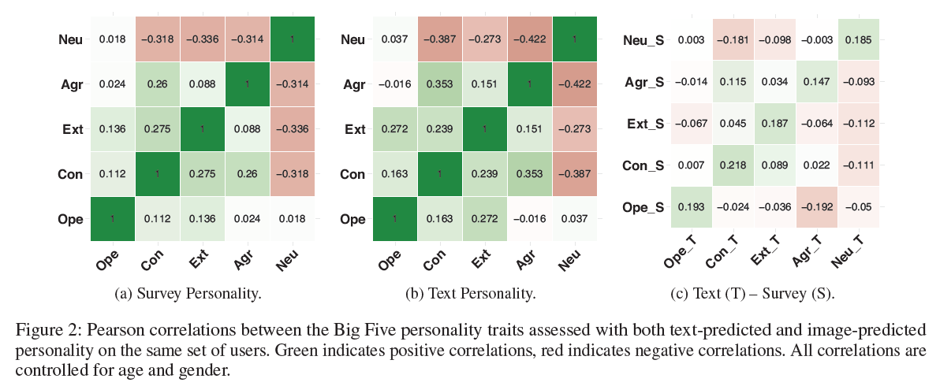

Slide 14
Image Extraction
Used public profile images as representative for a user. Although users can post other images, we focus on profile images, as the user has chosen these to represent their online persona and thus is most likely to contain important psychological cues.
to study and interpret people’s personalities from their profile pictures, stylistic characteristics rather than traditional computer vision features of the profiles are more appropriate.
Divide image features in two categories: general image features and stylistic facial features. The former contains basic color and facial information, while the later also includes facial expressions and postures extracted from the largest recognizable face from profile images.
Used two APIs based on deep learning – Face++ and EmoVu – for facial feature extraction.
Face++, which provides very accurate face recognition to indicate demographics and facial presentation. EmoVu offers more information about emotions expressed by the faces detected in the profile images
Notes:
Location was done by Prof Lee

Slide 15
Feature Categories
Color
divide images into grayscale images and color images.
For color images, they took their normalized RGB values and the average of the original colors. Colors are related to conceptual ideas like people’s mood and emotion.
Colors from images are related to psychologic traits:
red with ‘exciting-stimulating’ and ‘protective-defending’
green with ‘calm-peaceful-serene’
blue is connected with ‘secure-comfortable’ as well as ‘calm-peaceful-serene’.
Image Composition
measure aesthetic features of basic photographic composition rules.
First, we study the rule of thirds, where main object in the picture lies at the border or inside an inner rectangle of a 3 × 3 grid.
We capture this using two methods. We first compute the spatial distribution of the high frequency edges of an image.
We use the method from to estimate the edge distribution between the subject and background.
The number of unique hues of a photo is another measure of simplicity, based on the fact that good compositions have fewer objects, resulting in fewer distinct hues
Notes:
Location was done by Prof Lee

Slide 16
Feature Categories contd.
Image Type
extract basic face-related features for each profile picture as the number of faces it contains.
If there is no face in the profile image, look whether the user uses the one of the default Twitter profile picture images
Image Demographics
Age, gender and race are demographic features estimated from the profile images
Facial Representation
This category contains facial features related to the way a user chooses to present himself through his profile image
Features include the face ratio, whether the face wears any type of glasses, closeness of the subject’s face from the acquisition sensor, 3D face posture, which includes the pitch, roll and yaw angle of the face and eye openness.
Facial Expressions
Ekman’s model of six discrete basic emotions categorized as: +ve(joy, surprise); -ve(anger, disgust, fear, sadness)
EmoVu API extract these emotions from largest detected face in each profile image with neutral expression. It also gives composite features.
Expressiveness defined as the ‘interaction’ metric, is the highest value of the six basic emotions. Negative and positive mood are calculated as the maximum value of the positive and negative emotions respectively. Valence is the average of the negative mood and positive mood.
Notes:
Location was done by Prof Lee

Slide 17
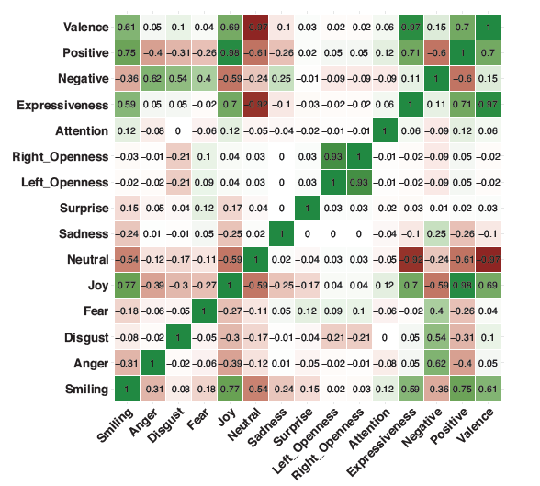
Feature Categories contd.
Correlations conform that smiling, joy, positive mood and expressiveness are largely positively correlated and the four are significantly negatively correlated with anger, neutral and negative mood. Eye openness is correlated with fear and anti-correlated with disgust.
Face++ was able to recognize 208 images with at least one face out of 429 from profile images for the TwitterSurvey data set and 36,402 out of 66,502 profile images for the TwitterText data set.
EmoVu was able to detect facial emotions for 124 out of 429 images for the TwitterSurvey data set and 26,234 out of 66,502 profile images for the TwitterText data set.
This was caused by different factors such as low image quality, very small face, or the face being obstructed by an object or not facing the camera. Similarly, color and image composition features only to images that were not default or grayscale.
Notes:
Location was done by Prof Lee

Slide 18
Analysis
Openness
Separated into the distinct, but correlated subtraits of “Intellectual engagement” and “Openness to Experience” indicates engagement with perceptual and aesthetic domains.
Users high in openness are significantly correlated to the majority of features indicative of better aesthetic quality of their photos.
Appealing images tend to have increased contrast, sharpness, saturation and less blur, which is the case for people high in openness.
Photos are anti-correlated with color emotions and are less colorful.
Edge distribution is the highest correlated feature, while smaller hue count, also indicative of simplicity is also correlated.
Dynamic lines which should reflect emotion are significantly anti-correlated, again confirming that photos of users high in openness are low in emotion, albeit of artistic and aesthetic quality.
In general, psychology research has shown that a person wearing reading glasses is more intelligent or has intellectual virtues
Notes:
Location was done by Prof Lee

Slide 19
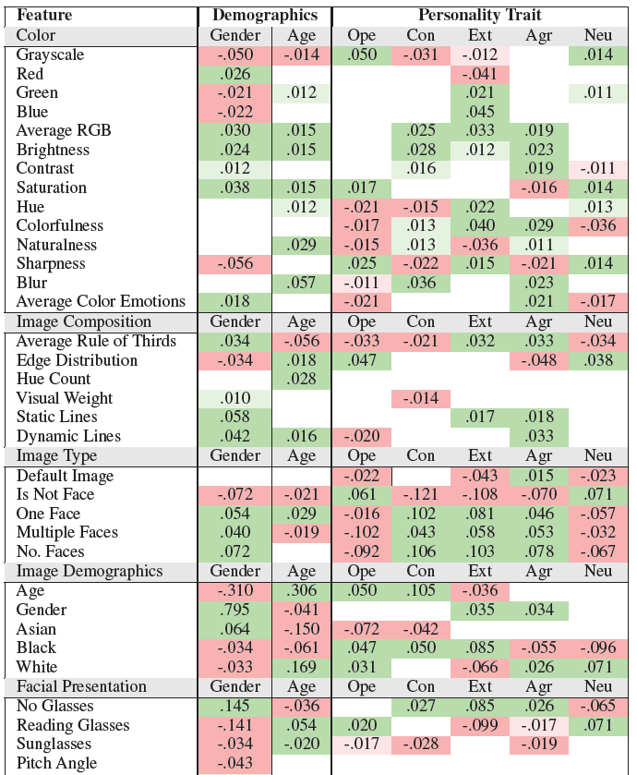
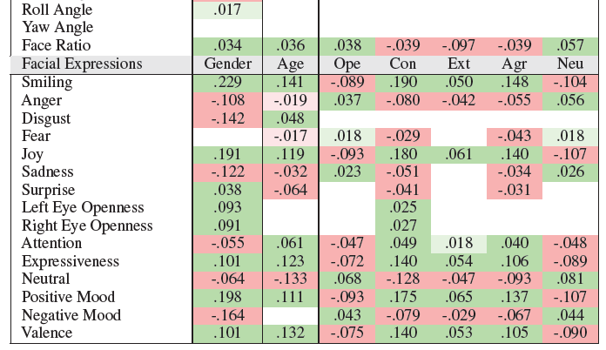
Pearson correlations between profile image and Big Five personality controlled for age and gender and with age and
gender (coded as 1 – female, 0 – male) separately. Positive correlation is highlighted with green (paler green p < .01, deeper
green p < .001, two-tailed t-test) and negative correlation with red (paler red p < .01, deeper red p < .001 , two-tailed t-test).

Slide 20
Analysis contd.
Conscientiousness
Conscientiousness is the personality trait associated with orderliness, planned behavior and self discipline.
These indicate that profile images with faces, especially with only one face, are good indicators of higher conscientiousness. This behavior can be caused by the fact that users high in this trait prefer the expected behavior
Conscientious users prefer pictures which are not grayscale and are overall more colorful, natural and bright.
Facial expressions are very indicative of conscientious people. The facial emotions of smiling, positive mood and valence are all highly positively correlated, while negative mood, especially anger and sadness, are anti-correlated.
Notes:
Location was done by Prof Lee

Slide 21
Analysis contd.
Extraversion
Extraversion is trait marked by engagement with the outside world.
These type of users are correlated the highest out of all traits with colorful images.
Their photos do not have any correlation with the color attributes that make photo aesthetically pleasing (contrast, saturation, lack of blur), with the exception of a positive correlation with sharpness.
Similar to conscientiousness, extraversion is largely related to the number of faces of the profile pictures, albeit extraverts slightly prefer images with more people.
Different from all other personalities, extraversion is negatively correlated with the age of the presenting faces, which means that users either appear younger in their profiles or are photographed with other young(er) people.
With the strongest correlation compared to other personalities, extraverts have a small face ratio, perhaps caused by the multiple people present in the picture or showing of more of their body or environment.
Agreeableness
agreeableness trait is characterized by social harmony and cooperation.
Users high in this trait like to have profile pictures with faces in them.
For colors, the correlations are almost all opposite to those for openness
They use colorful pictures (but to a lesser extent than extraverts) which are low in sharpness, blurry and bright.
Neuroticism
Neuroticism is associated with the experience of negative emotions and emotional instability.
It is usually anti-correlated with agreeableness and extraversion.
Photos of neurotic people are perhaps unsurprisingly anticorrelated with colorfulness.
Display simple, uncolorful images with negative color emotions.
This is similar for openness, the photos of neurotic people do not display the aesthetic features that characterize openness.
Neuroticism displays, both a lack of positive emotions and, to a lower extent, the presence of negative emotions.
Notes:
Location was done by Prof Lee

Slide 22
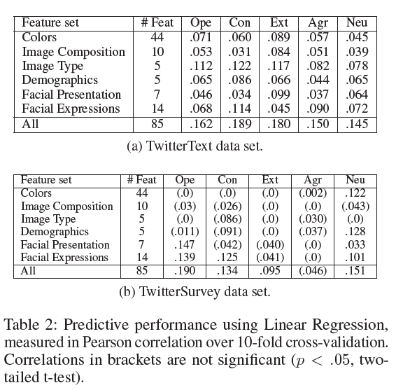

Slide 23
Prediction
Investigated the accuracy of using interpretable visual features to predict the personality traits.
Used linear regression with Elastic Net regularization for prediction.

Slide 24
Conclusion
Users that are either high in openness or neuroticism post less photos of people and when these are present, they tend not to express positive emotions.
Difference between the groups is in the aesthetic quality of the photos, higher for openness and lower for neuroticism.
Users high in conscientiousness, agreeableness or extraversion prefer pictures with at least one face and prefer presenting positive emotions through their facial expressions.
Conscientious users post more what is expected of a profile picture: pictures of one face that expresses the most positive emotion out of all traits. Extraverts and agreeable people regularly post colorful pictures that convey emotion, although they are not the most aesthetically pleasing, especially for the latter trait.

Slide 25
Strength | Weekness
Used great example to explain the correlation between personality traits and profile picture
Overcame the problem of previous work by taking 60000 users
First large scale study of profile pics.

